Slide 1
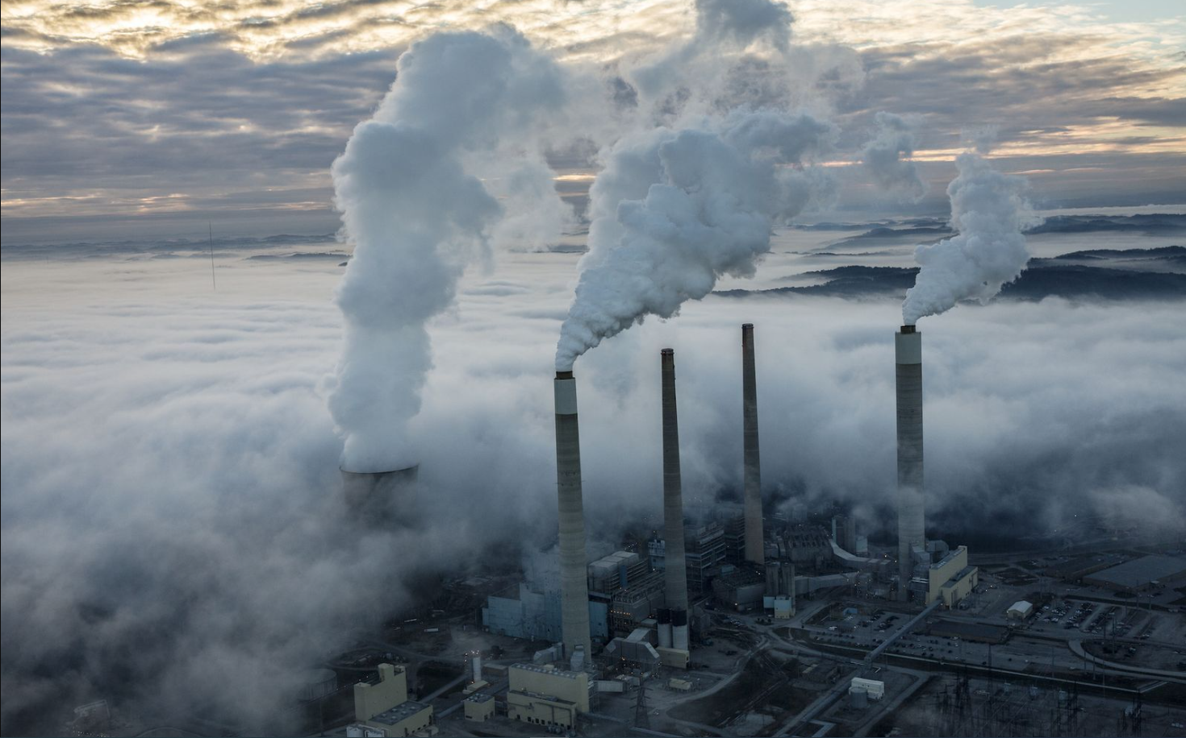
2024 Climate Change Case Study
Created by Adrian Bayemi, Catherine Matthews, and Damilare Omoboriowo
What are the effects of climate change on Earth's surface temperature, air quality, and the prevalence of natural disasters?

Slide 2
General Overview & Outline
1. Global Earth Surface Temperature
2. Air Quality
3. Prevalence of Natural Disasters
Overview & Outline
Synopsis:
Brief overview of problem statement and summary of evidence supporting climate change
Coding:
Demonstrate the process behind creating visuals for each topic using code
Global Earth Surface Temperature
Improving Air Quality Index (AQI)
Increased Frequency and Occurrence of Natural Disasters:
Conclusion:
Closing statement

Slide 3
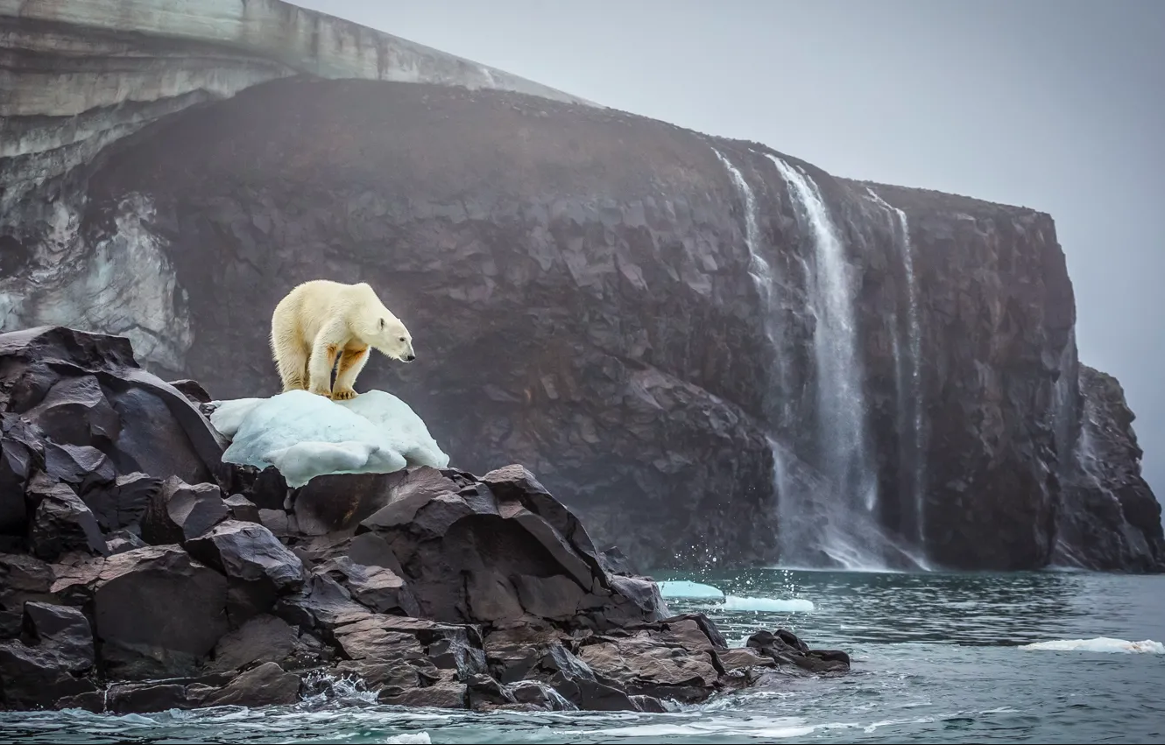
Synopsis
Problem Statement
The impacts of global warming are becoming more apparent and significantly deteriorating. Over the past 40-50 years, there has been a clear link between rising temperatures and greenhouse gas emissions, alongside a surge in extreme weather events, rising sea levels, and the melting of ice caps, all indicative of climate change.

Slide 4

Evidence of Climate Change (Part 1)
1. Melting Glaciers and Sea-Level Rise:
Glaciers are retreating at an alarming rate worldwide, and sea levels have risen by about 20 cm in the last century.
2. Extreme Weather Events:
There has been an noticeable increase in the frequency and severity of extreme weather events. These include heatwaves, droughts, and heavy rainfall.
3. Shift in Seasons:
Climate change is causing a shift in the timing of seasonal events. Many regions are experiencing earlier springs and later autumns.
4. Increase in Greenhouse Gases:
The concentration of carbon dioxide (CO2) has increased by about 40% since the Industrial Revolution. Primarily due to human activities such as burning fossil fuels and changing land use.

Slide 5
Earth Surface Temperature
Earth's temperature has risen by an average of 0.11° Fahrenheit (0.06° Celsius) per decade since 1850, or about 2° F in total. The rate of warming since 1982 is more than three times as fast: 0.36° F (0.20° C) per decade. Some say climate change is the biggest threat of our age while others say it’s a myth based on dodgy science. We are turning some of the data over to you so you can form your own view.

Slide 6

Earth Surface Temperature Evidence
5. Global Average Temperature:
The Earth’s Average surface temperature is about 59 degrees Fahrenheit. In 2023, Earth experienced its hottest summer on record. Yet at the same the 2023 global ecological tells us that conditions are getting better. This dataset sheds on the current environmental trends
6. Temperature Extremes:
The coldest temperature recorded on Earth was -128.6 degrees Fahrenheit at Vostok Station, Antarctica, on July 21, 1983.
The hottest temperature was 134 degrees Fahrenheit at Greenland Ranch, Death Valley, California, on July 10, 1913.

Slide 7
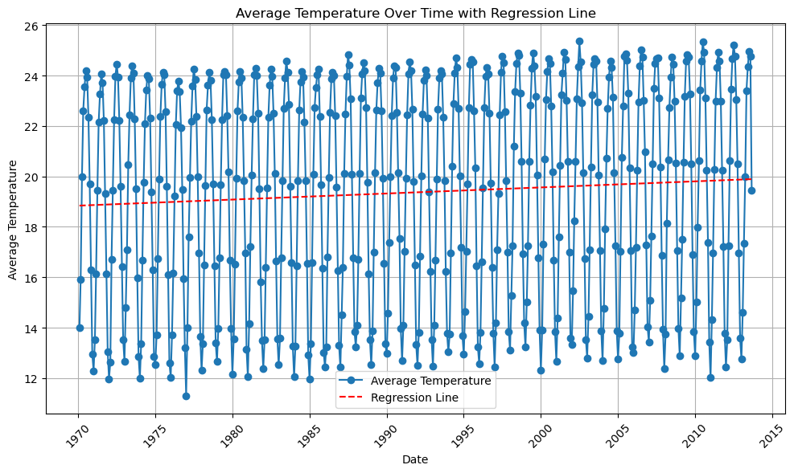

Slide 8
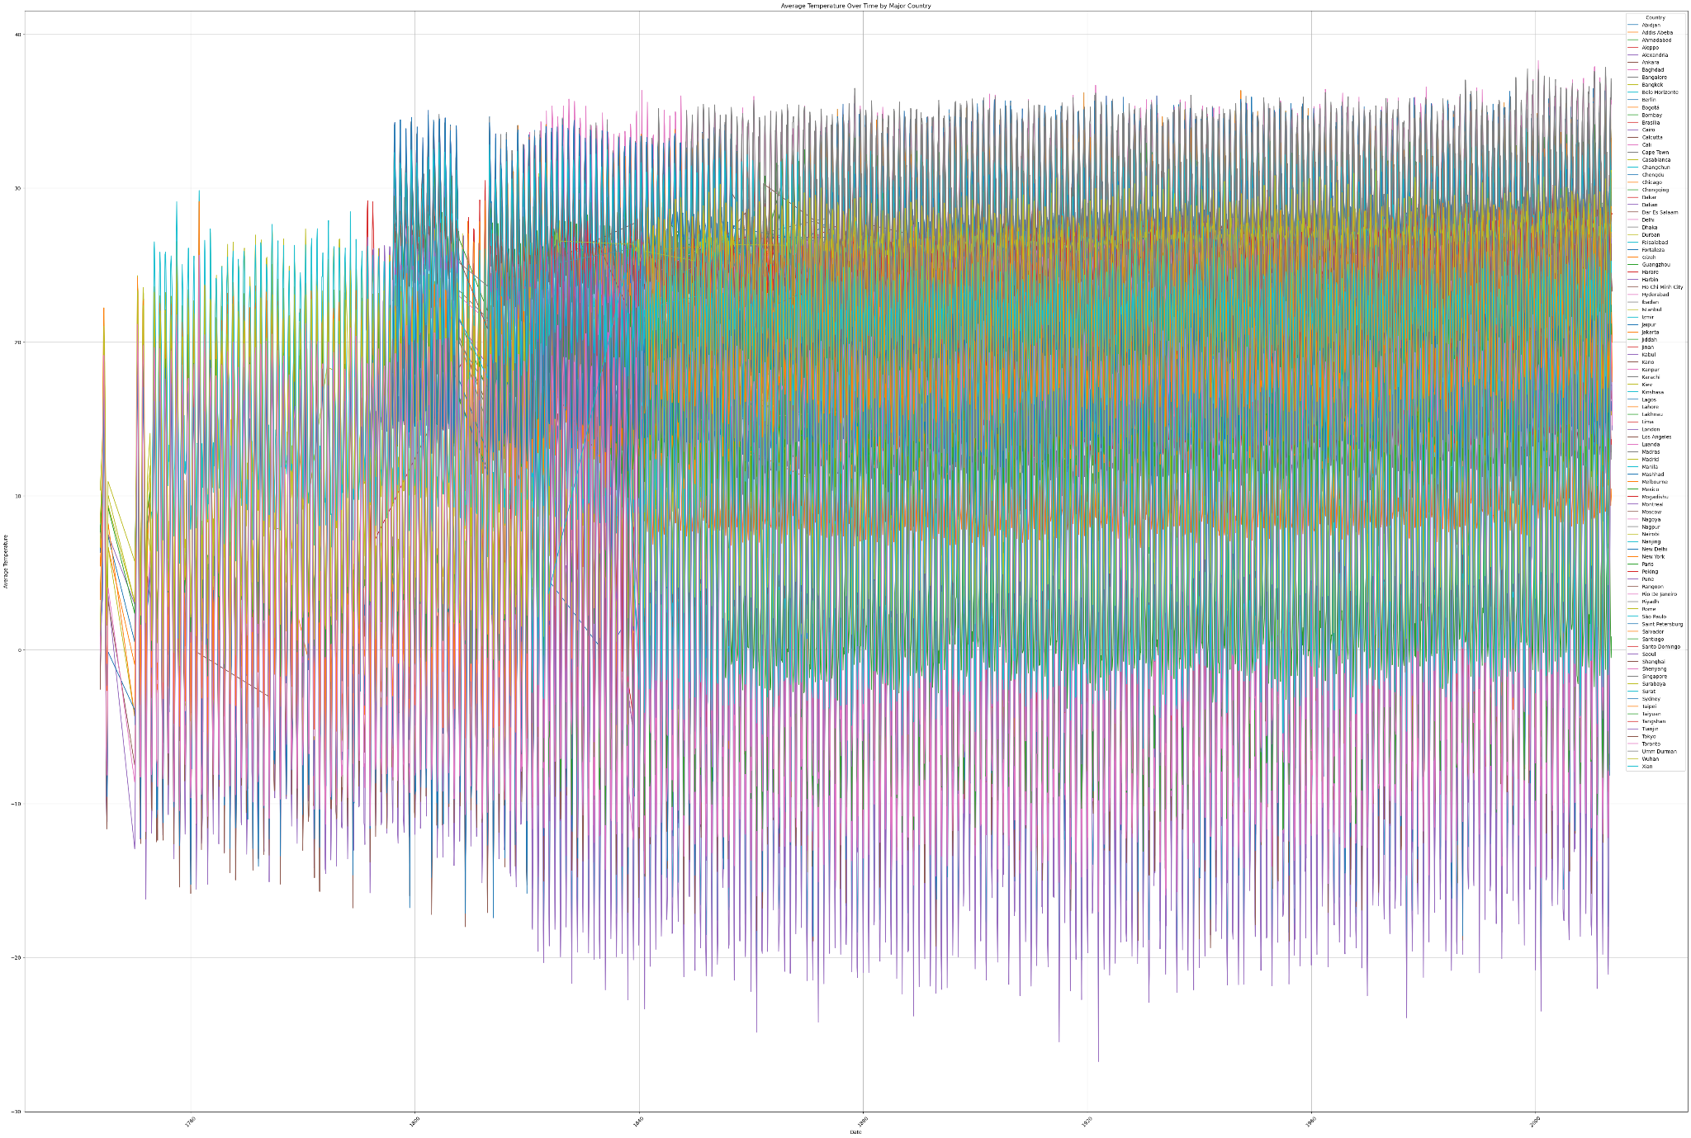

Slide 9
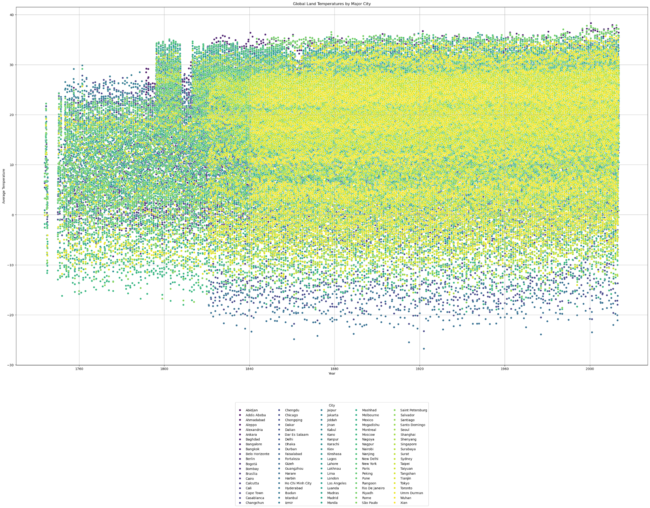

Slide 10
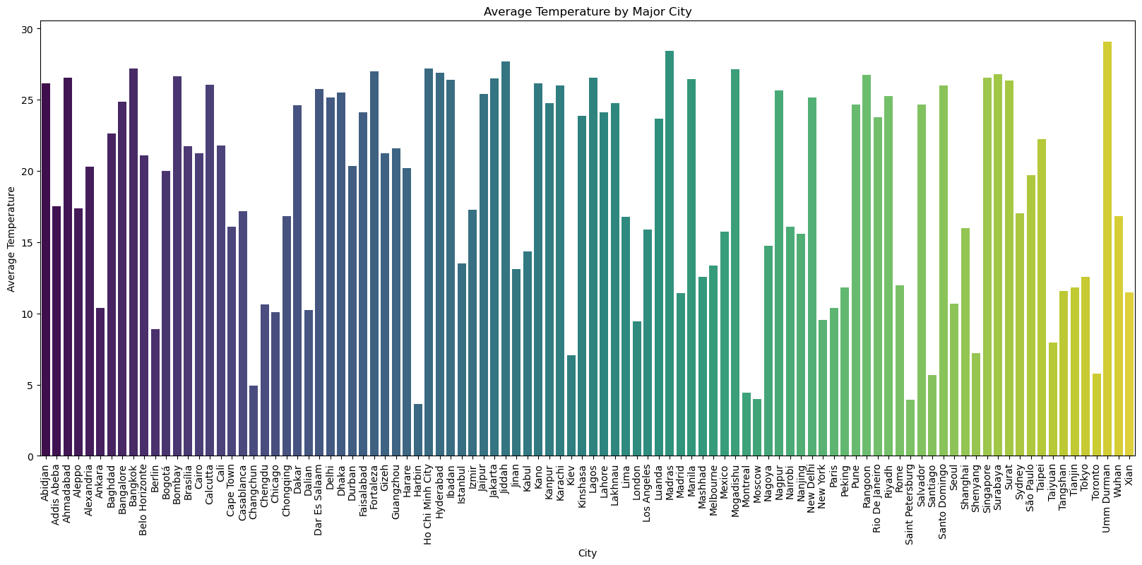

Slide 11
Air Quality from 1980 - 2015
"Since 1980, the United States has seen a significant improvement in air quality, with:
- Carbon monoxide levels plummeting by 84% through 2015
- Lead concentrations dwindling by a remarkable 99% over the same period
- Annual nitrogen dioxide levels decreasing by 60% from 1980 to 2015
- Particulate matter (PM10) concentrations reducing by 39% from 1990 to 2015
Trends in air quality in the United States from 1980 - 2015

Slide 12
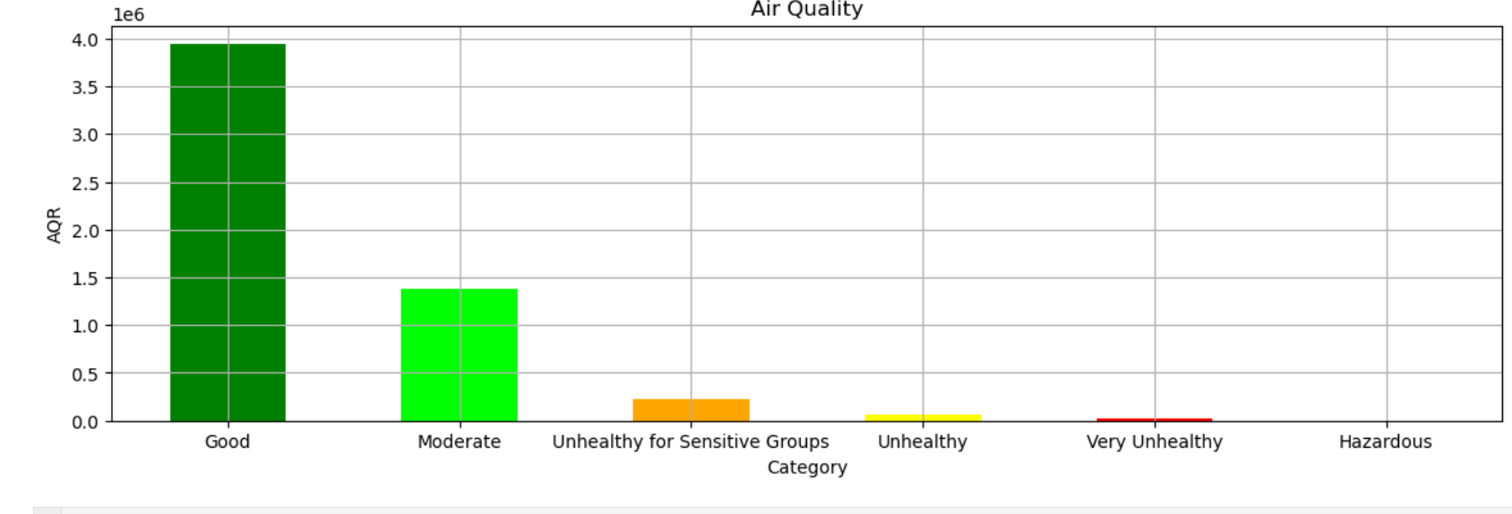
Case Studies and Examples of Air Quality (Part 1)
1. London Smog (1952): A severe air pollution event caused by coal burning and fog, resulting in an estimated 4,000 premature deaths.
2. Los Angeles Smog (1940s-1960s): High levels of ozone and particulate matter led to respiratory problems and visibility issues, prompting the establishment of the California Air Resources Board.
3. New Delhi Air Pollution (2010s-present): High levels of particulate matter and other pollutants have led to severe health issues and visibility problems, prompting government actions to reduce emissions.
4. Beijing Air Pollution (2000s-present): Rapid industrialization and coal burning led to severe air pollution, resulting in health issues and economic losses.

Slide 13
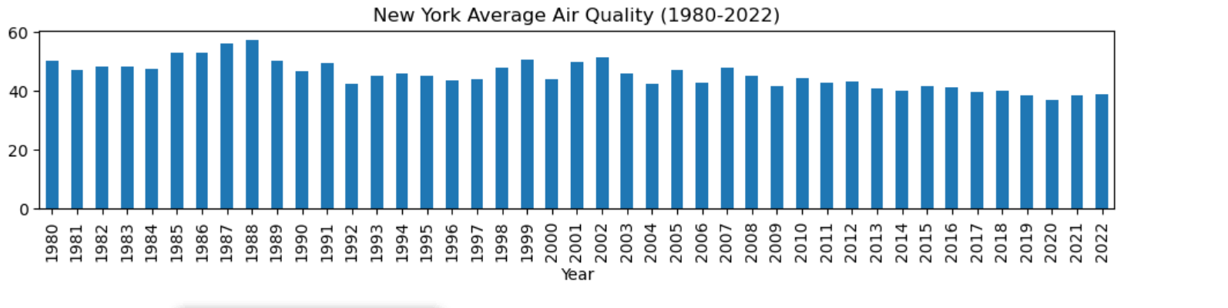
Case Studies and Examples of Air Quality (Part 2)

Slide 14

Natural Disasters
Understanding the connection between Climate Change and Natural Disasters

Slide 15
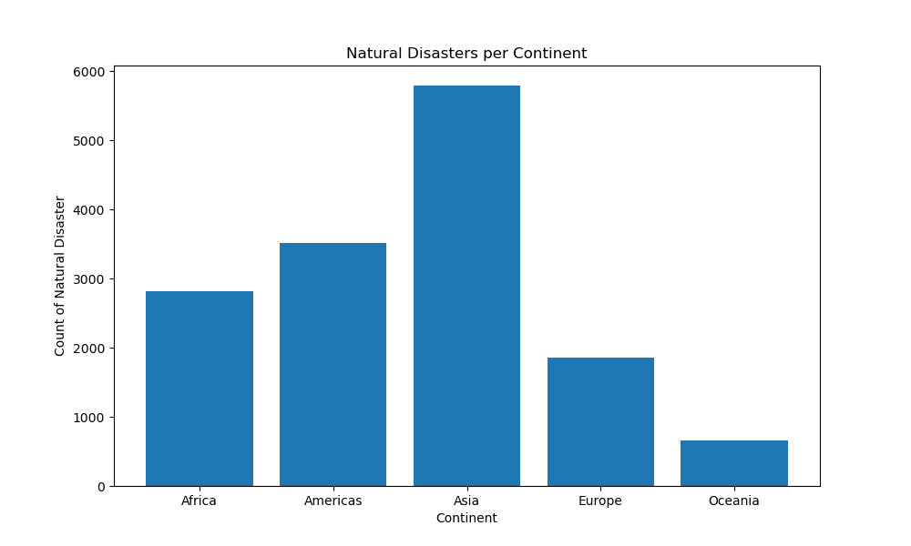
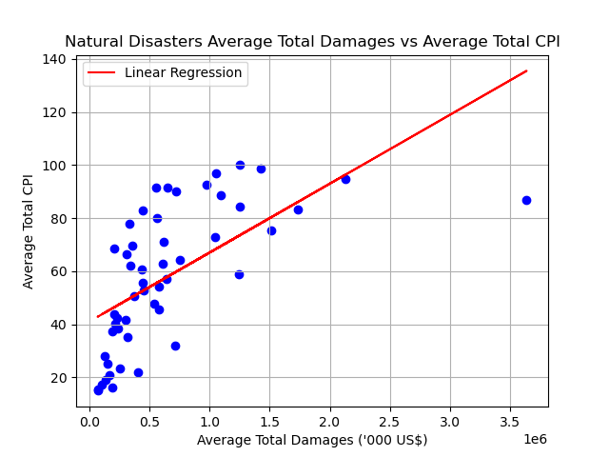
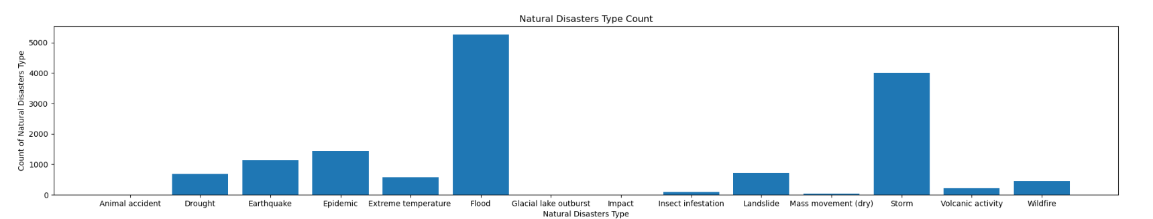
What are Natural Disasters
Definition:
Natural Disasters are highly destructive, harmful, or ruinous events that occur due to the natural processes of the earth and can leave a huge impact on a population and disrupt existing social and economic infrastructures.
Examples:
Droughts, earthquakes, storms, extreme temperatures, floods, and wildfires.
Byproduct:
Natural Disasters may cause fatalities, injuries, environmental damage, and property damage.

Slide 16
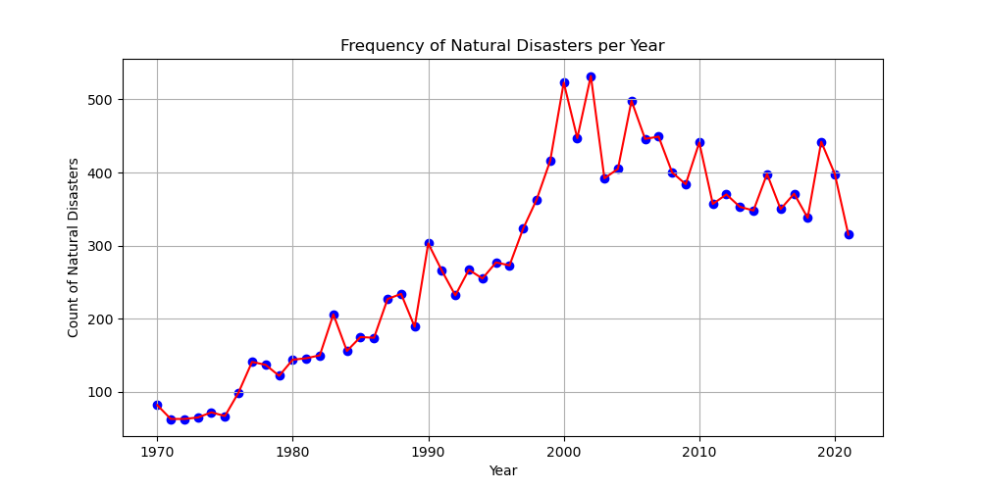
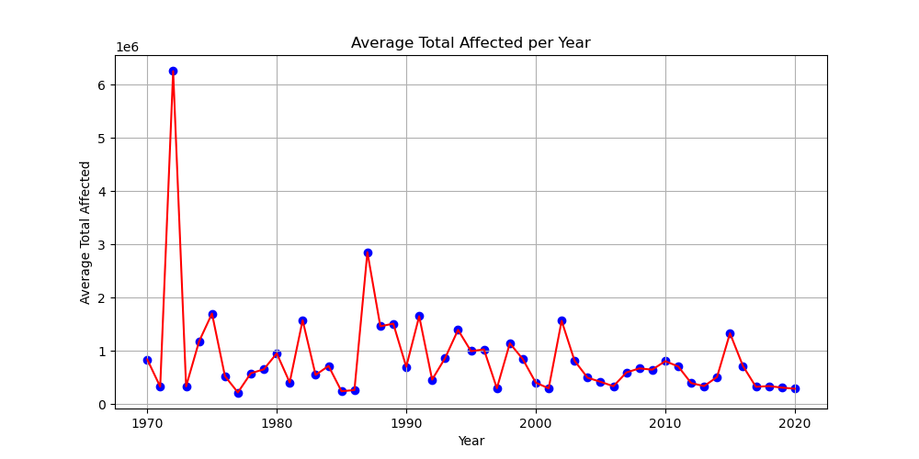
Impact of Climate Change on Natural Disasters
Increased Frequency and Severity of Heatwaves:
Rising temperatures result in more frequent and extended heatwaves, leading to heat-related illnesses and fatalities
More Intense Hurricanes and Typhoons:
Warmer ocean temperatures and rising sea levels amplify hurricanes and typhoons, leading to greater damage and flooding
Water Scarcity and Food Insecurity:
Change in precipitation patterns and higher temperatures contribute to water shortages and food insecurity

Slide 17
Conclusion: 2023 Global Ecological Report
Where have we been and where are we going
The Ecological Footprint of Consumption quantifies the ecological resources needed by a given population to generate the natural resources it uses (such as wood and other forest products, livestock and fish products, space for urban infrastructure, and plant-based food and fiber products) and to absorb waste, particularly carbon emissions. The six categories of productive surface areas that are tracked by the footprint are: forest area, farmland, grazing land, fishing grounds, built-up (or urban) land, and carbon demand on land.The productivity of a country's ecological resources, such as its built-up land, grazing land, forests, fishing grounds, and agriculture, is measured by its biocapacity. These places have the capacity to absorb a large portion of the garbage we produce, particularly our carbon emissions, especially if it is left unharvested.

